Slide 1

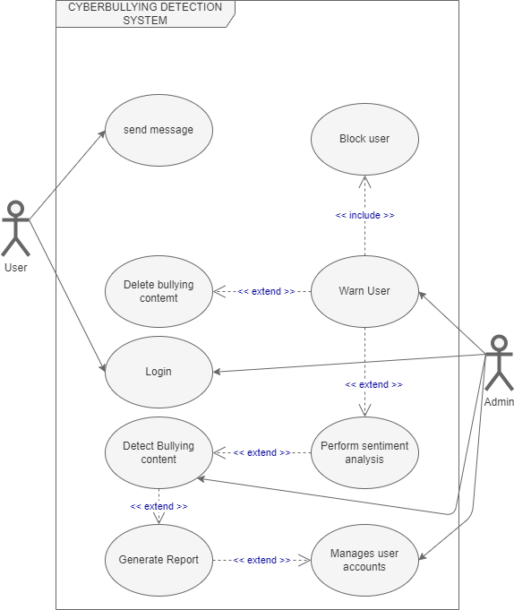
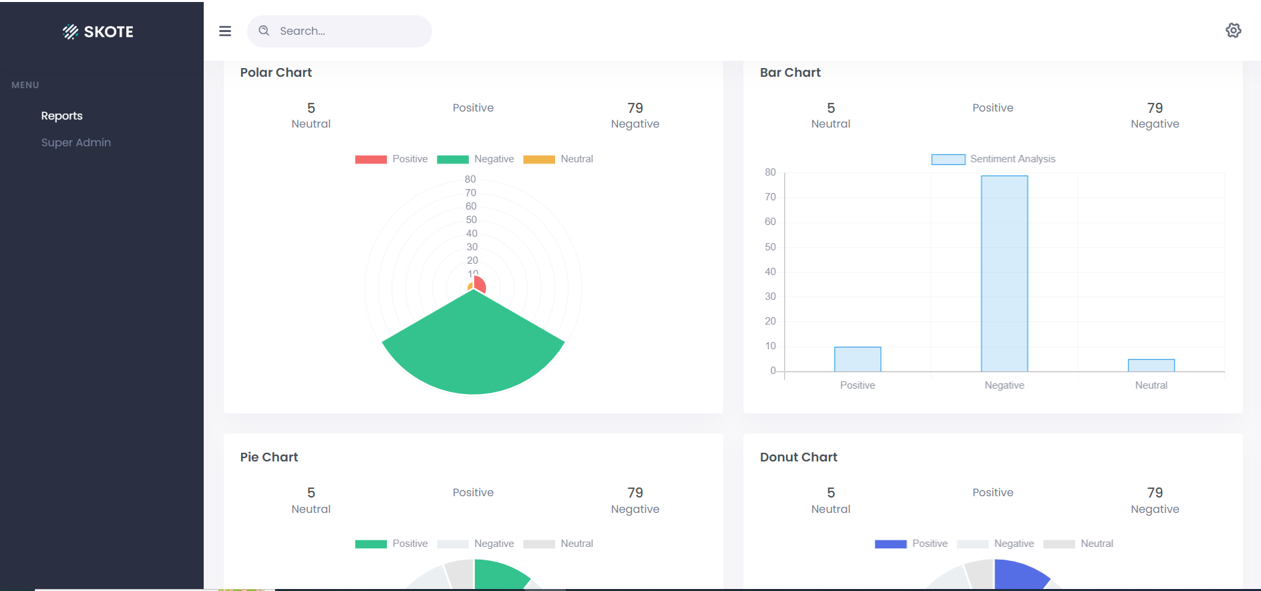
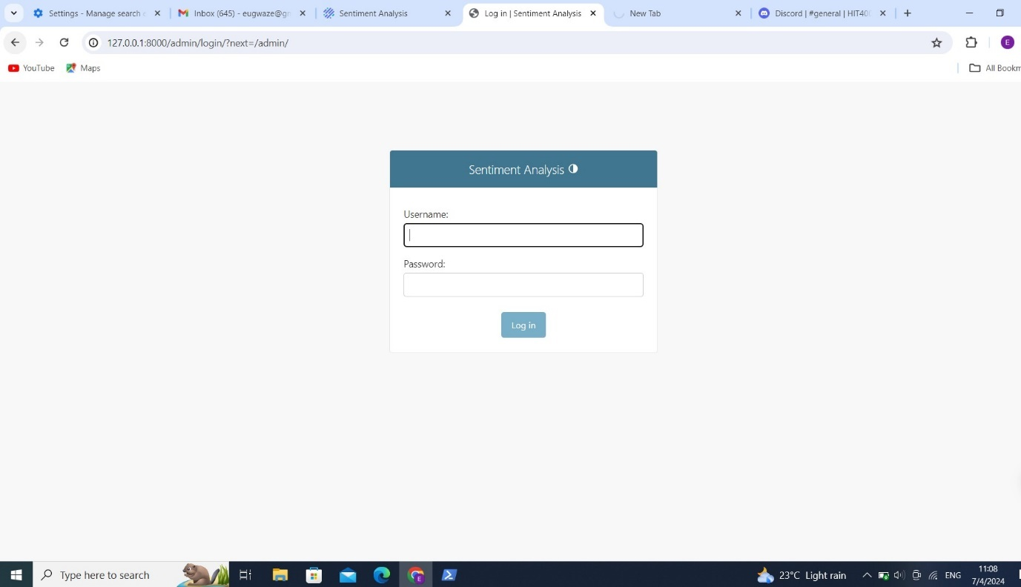
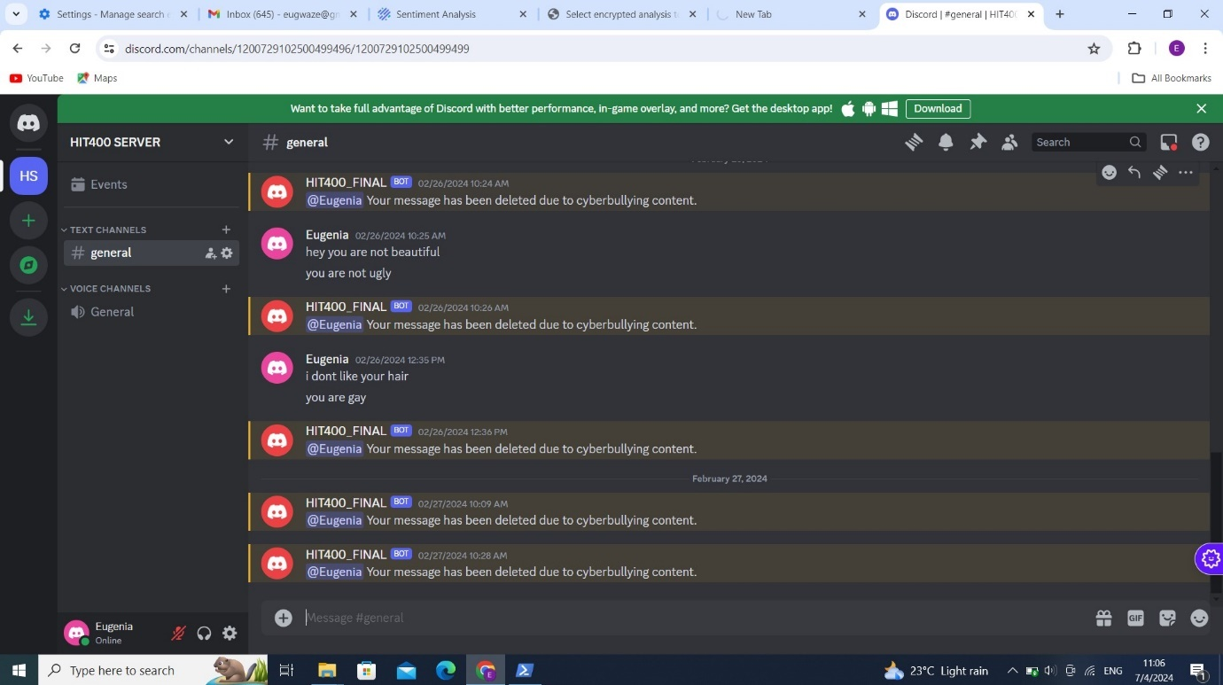
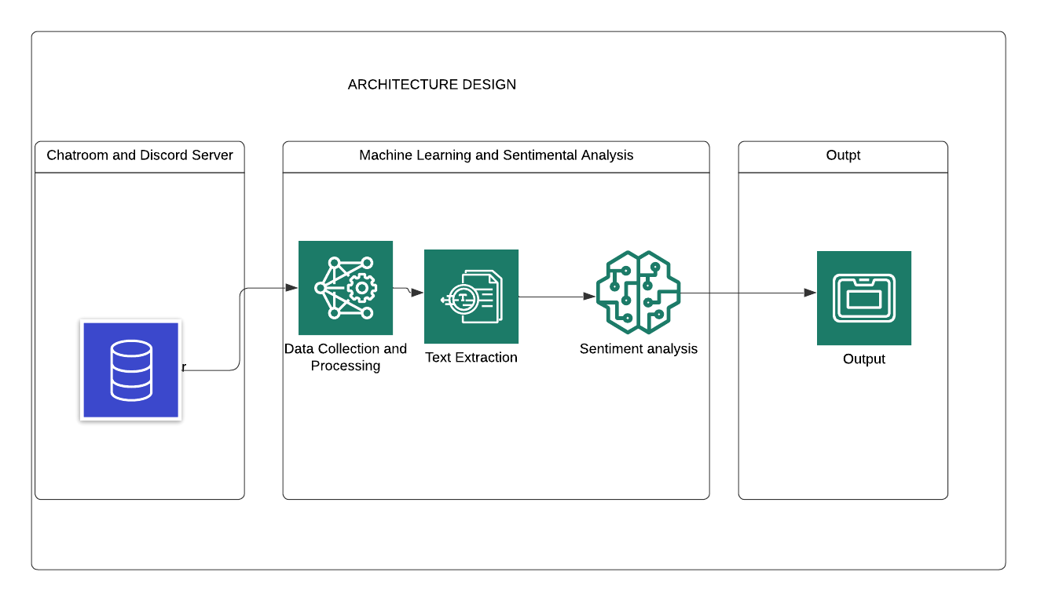
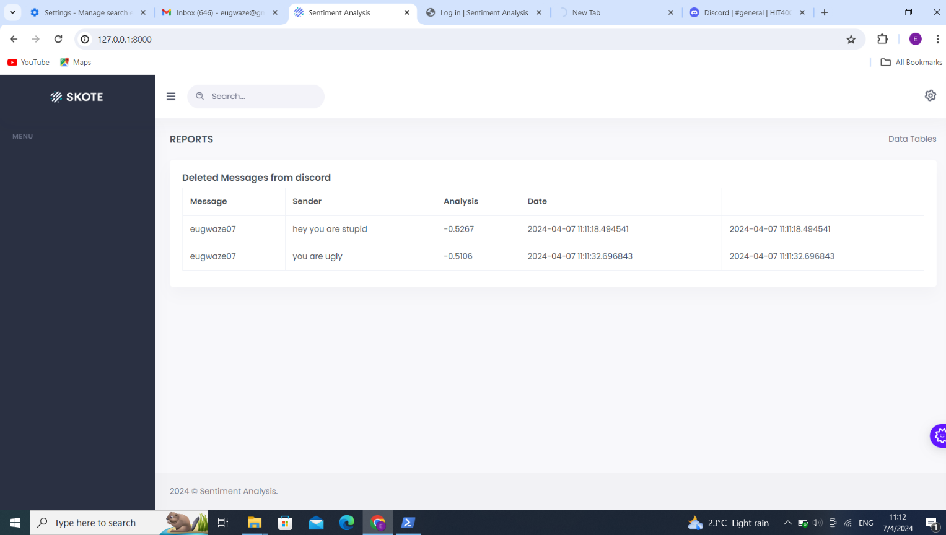
CYBERBULLYING DETECTION SYSTEM
Eugenia Gwaze (H200843Y)- Software Engineering Department
In the virtual world, anonymity and distance can often lead to fear and intimidation. This system aims to create a safe and secure environment for users to interact in, free from any such fears. It seeks to enrich their online gaming experience by fostering an environment where they can interact without any fear of cyberbullying.
V.
1.0 Abstract
7.0. Use Case Diagram
Cyberbullying has become a concerning issue in online game chat rooms. To tackle this problem, I have propose a Cyberbullying Detection System that uses Sentiment Analysis to identify cyberbullying behaviour in English language chat rooms. The primary objective of this system is to create a safe and secure online gaming environment by analyzing chat room messages for sentiment and producing activity reports.The system architecture has been meticulously designed to perform unsupervised and temporal sentiment analysis on text messages. This enables the early detection of cyberbullying instances and prompt implementation of preventative measures.
Moreover, the system has robust data security features such as key encryption and master signing mechanisms to safeguard user data. Overally, this system has the potential to significantly improve the safety and security of online game chat rooms by providing a strong defence against cyberbullying and ensuring the well-being of users in these virtual spaces.
4.0. Overview of the developed application
The proposed system is aimed at detecting cyberbullying through sentiment analysis, making use of machine learning technology. The system will consist of three main modules: the machine learning model, the chat module (based on Discord), and the admin module for reports and database management.
1. The machine learning model is responsible for analyzing the natural language used in the Discord chat server and determining its polarity, or in other words, whether it is abusive or not.
2. The chat module is the platform where gamers can socialize and chat with each other. In this instance, the chat module will be based on Discord.
3. The Admin module will manage the database and display all messages that have been flagged as cyberbullying content.
Conclusion
In conclusion, the "Cyberbullying Detection System" project successfully developed an automated system capable of detecting cyberbullying instances in online platforms. The system's deployment has contributed to creating a safer online environment by promptly identifying and addressing instances of cyberbullying, thus helping protect individuals from online harassment and abuse.
Recommendations
Expanding the system's reach beyond Zimbabwe and all communication platforms can greatly benefit the fight against cyberbullying, as cyberbullying is a global issue. By implementing the system in other countries, the system can be fine-tuned to better detect and prevent cyberbullying in different cultures and languages as. Additionally, expanding the system to work with a greater variety of game chat rooms will increase its effectiveness, as different games may have different types of cyberbullying occurring.
Furthermore, by making the system more accessible to users, such as by developing a mobile application, the system can have a greater impact in reducing cyberbullying. Mobile devices are often the primary device used for gaming and social media, so having a mobile application would increase the targeted reach of users and allow them to use the system more easily and frequently. This, in turn, can increase the amount of cyberbullying that is detected and prevented
8.0. Screenshots
2.0. Introduction
5.0. Objectives
Cyberbullying is an oppression happening virtually using devices such as computers, mobiles, and tablets. Cyberbullying can take place through messaging or on the internet in forums, social platforms, or gaming where community can share and post their thoughts. In short, social media are being used by bullies to harass people. Bullying can be analysed by consecutive behaviour and a purpose to harm which leads to having suicidal ideation, emotional responses and lower self-esteem such as the victim being angry, frustrated, scared and depressed. Children, in today’s world, want their own mobiles and tablets at an adolescent age, and desire to connect to the social media platforms, and play online games such as Fortnite. If their behaviour goes unmonitored by their parents, then it may lead to cyber bullying. Examples of cyberbullying can include rumours posted on social media or sent by e-mail; embarrassing videos or pictures; and insulting, intimidating and abusive messages posted on social networks. When a message or a picture is posted online, it is very difficult to track and remove the content from the social media
To perform sentiment analysis on text messages to predict cyberbullying in game chatrooms
To notify the Admnistrator when cyberbullying text is detected.
To block and delete cyberbullying text
To generate a report of the activites in the system
6.0. System Overview
3.0. Problem definition
This project aims to create a unique Cyberbullying Detection System that can identify instances of cyberbullying in the English language. This system has the potential to significantly impact the safety and well-being of users in online game chat rooms. The main purpose of this system is to act as a vigilant guardian, constantly monitoring and responding to cyberbullying incidents. With the help of advanced technological tools, such as sentiment analysis and real-time monitoring, it can provide a comprehensive shield against harmful online behaviours.
Supervisor- Eng W Makondo

